Slide 1
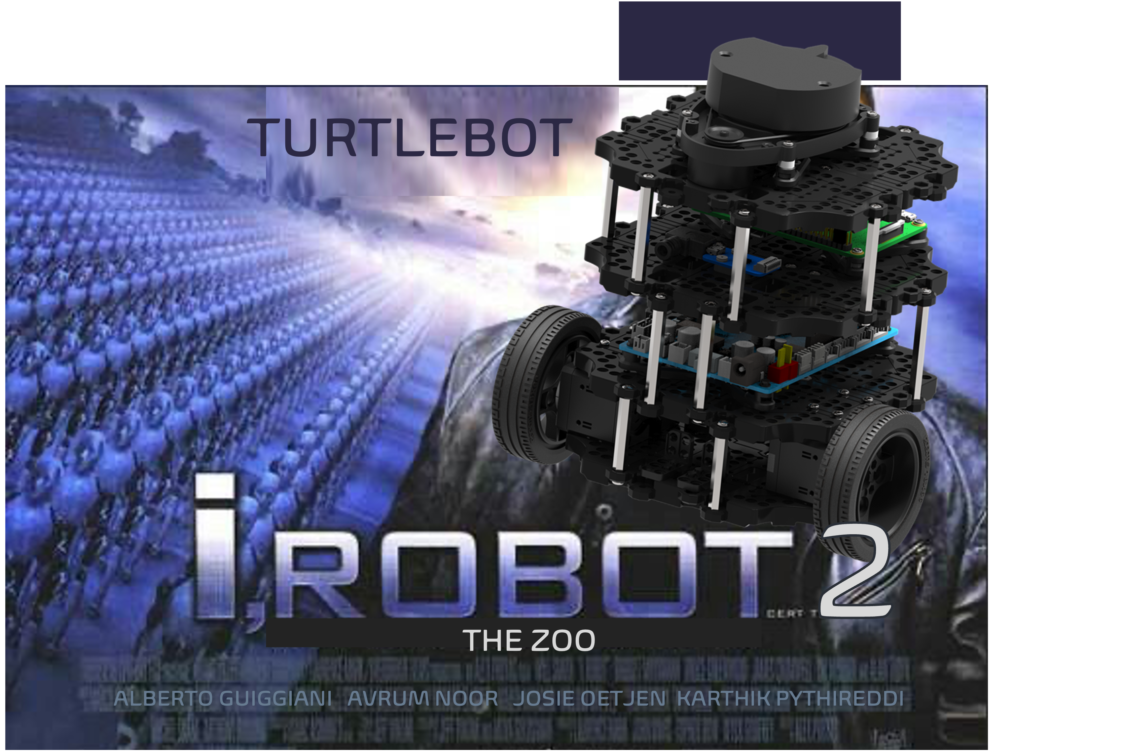
AA 274A Final Project

Slide 2







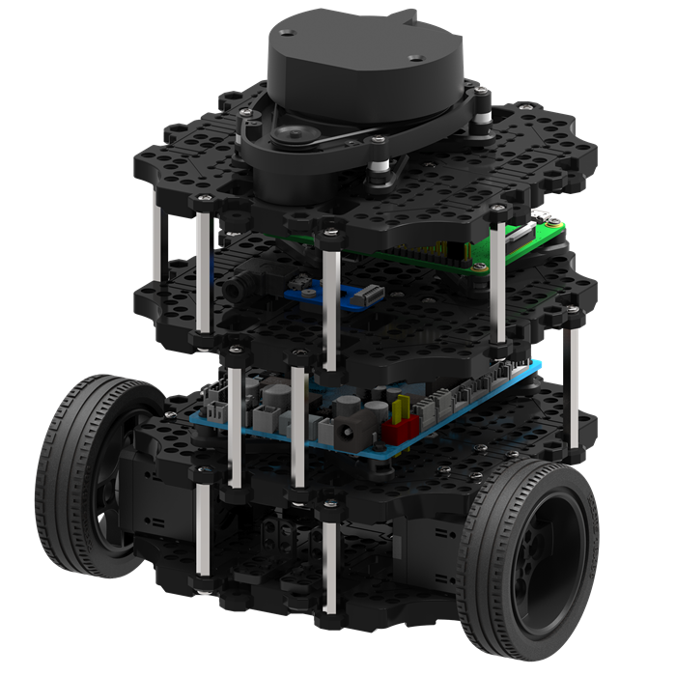
Backstory
iRobot2 – the Zoo
In the year 2122, robots have taken over the world and keep all animals and humans, including Will Smith, hostage.
However, among all the evil robots, one good one is still left, Turtlebot. Although admittedly inferior in terms of technology and design, his goodwill and courage make him the biggest hope for humankind.
In a crucial mission, he has to rescue animals and humans from a so called zoo.

Slide 3
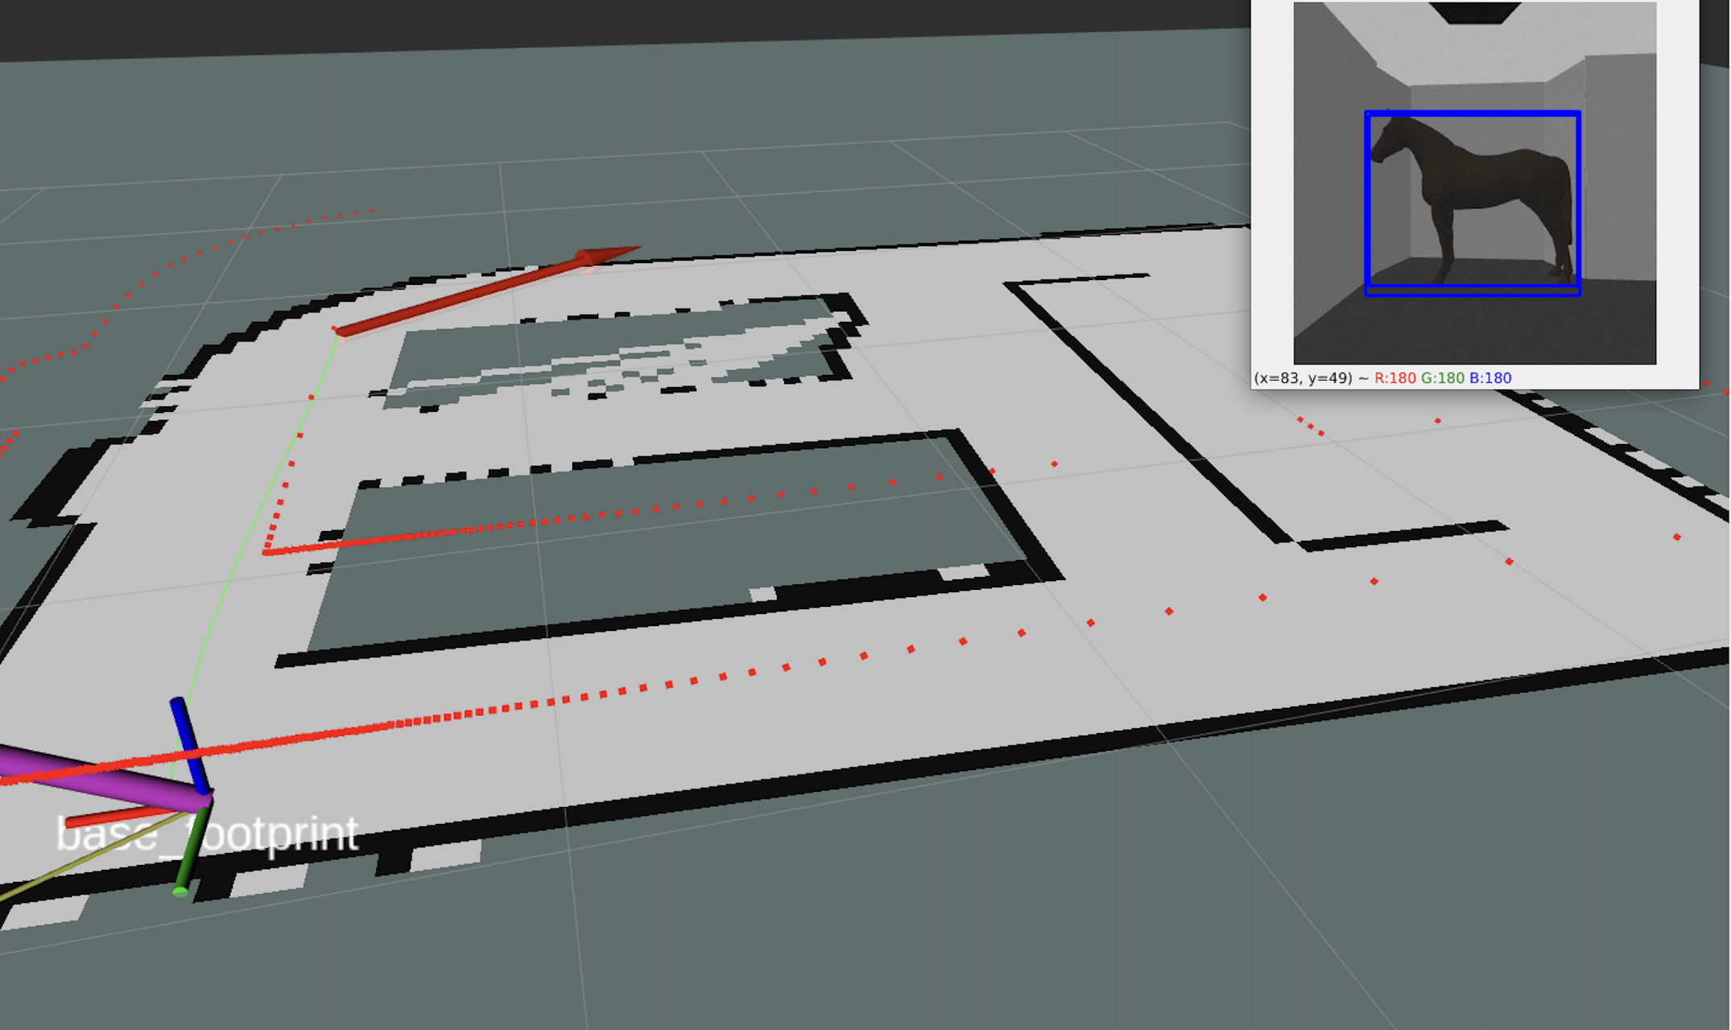
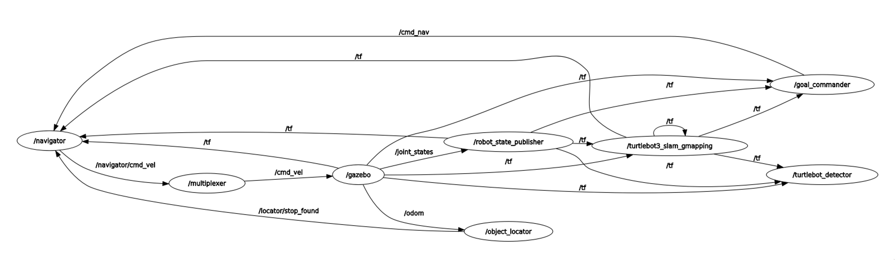
Baseline Mission
We manually set several waypoints needed to explore the map
While exploring the map, the turtlebot’s object detector localizes different animals and humans and saves their type and position
After the exploring the map fully, turtelbot start his rescue missions in the user defined order

Slide 4
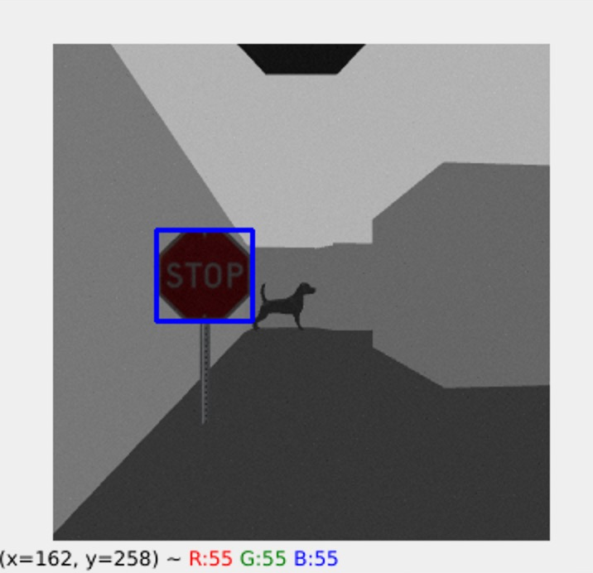
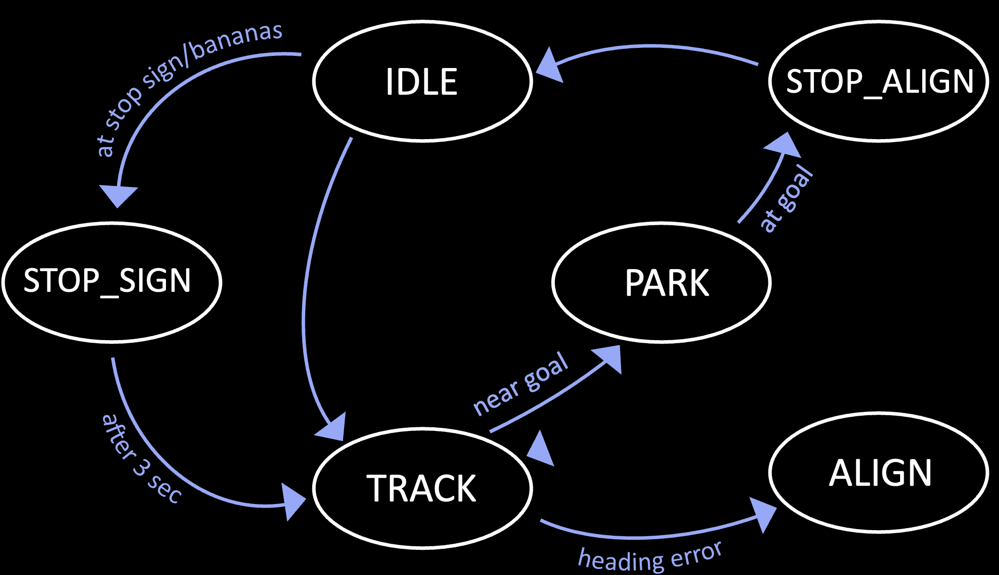
Extensions
1. Stopping at stop signs and bananas
Despite his high focus on completing the mission quickly, turtlebot stops at stop signs
Also, his weakness is his love of bananas, so when he finds one, he can’t resist briefly snacking on it
The navigator switches to the STOP state when it receives a stop found message from the locator
It stops for 5 seconds and adds a crossing logic to ignore objects for the next 3 seconds to prevent from stopping for the same object again.

Slide 5
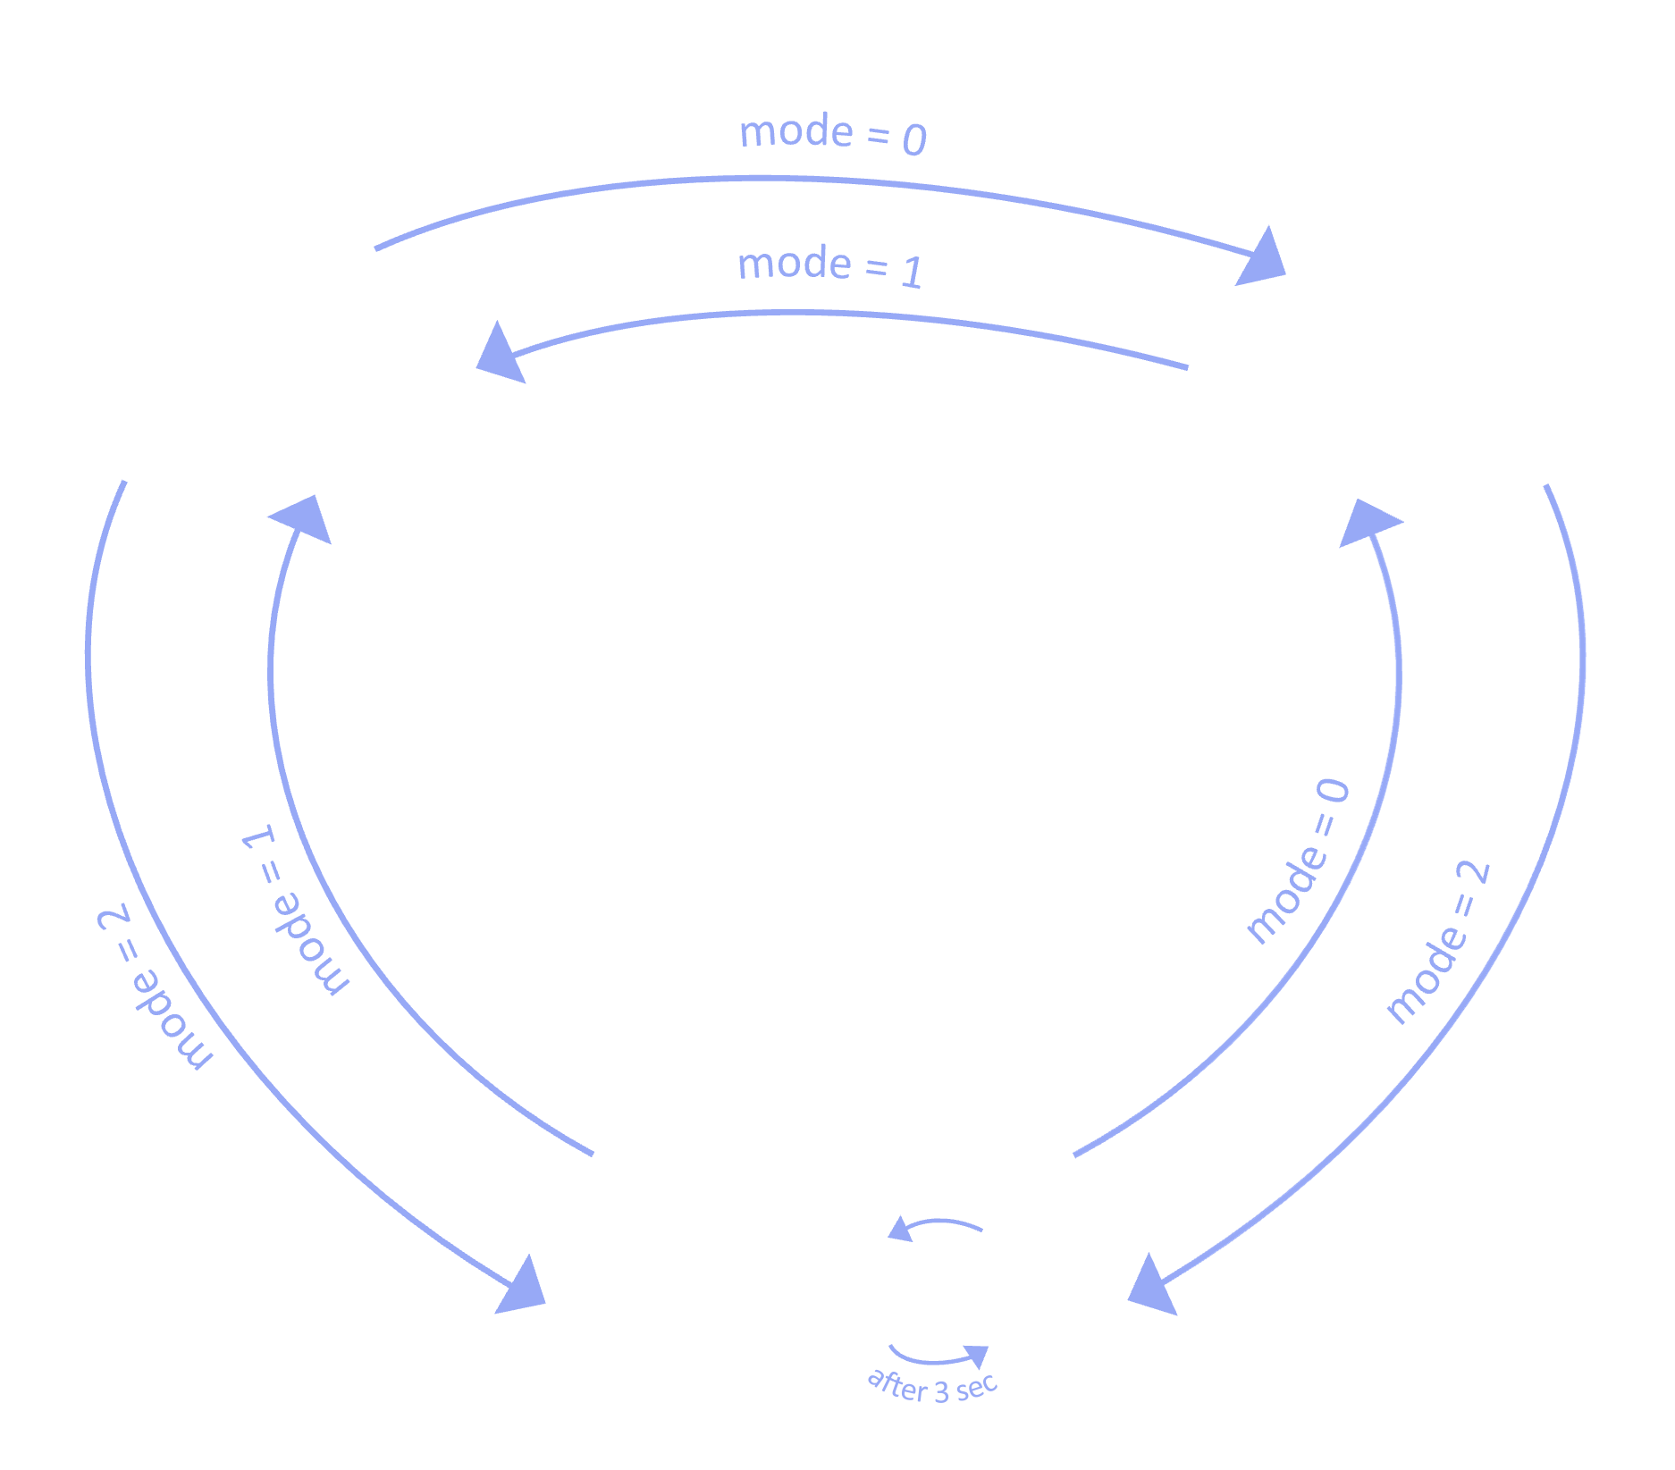
Extensions
2. Smart multiplexer
Multiplexer with three modes of operation:
Autonomous control: Routes the robot autonomously by consuming the commanded velocity from the navigator
Manual control: Uses the keyboard commands to manually teleport the robot
Hybrid control: Toggles the robot between the autonomous and manual modes depending on the latest message received.
(We added a 0.5-second grace period after receiving a manual input to avoid the autonomous system interrupting the user request)

Slide 6
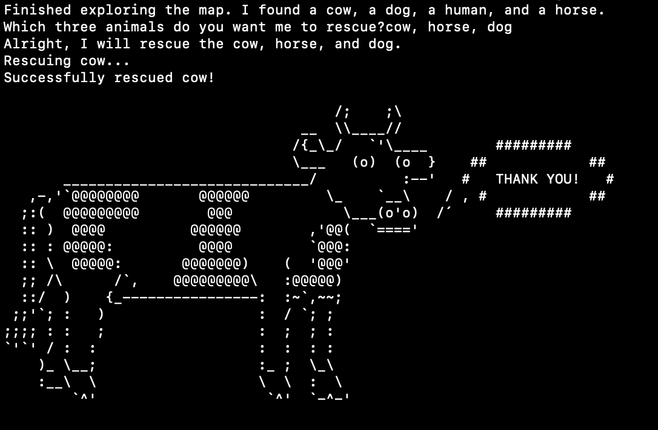
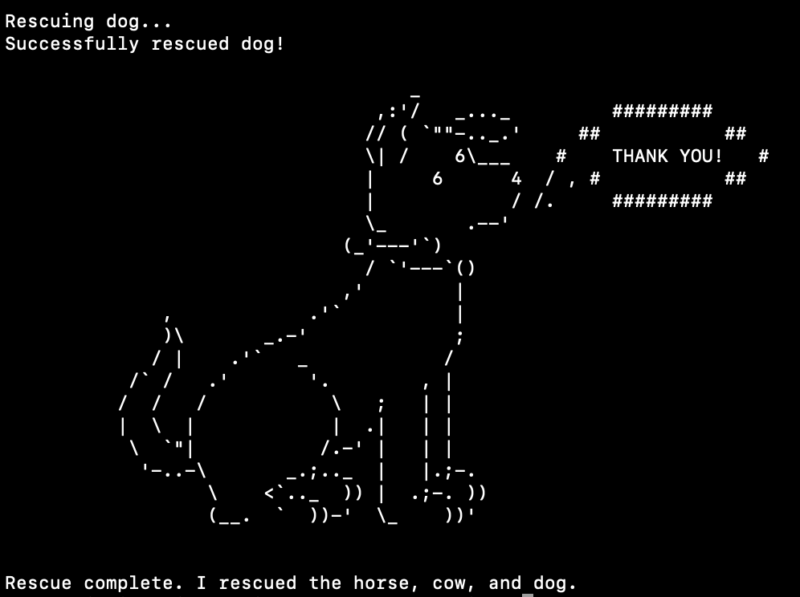
Extensions
3. Interactive interface and polite animals
After map exploration, the system (aka turtlebot) informs the user which animals he found and asks which animals to rescue
The user enters the animals he wants turtlebot to rescue with his keyboard in the desired order
If animals entered were not found, the system gives feedback on which animal is missing. Otherwise, turtlebot starts the rescue mission and prints the current status of the mission
Animals are delighted when rescued and say thank you with cute pictures

Slide 7
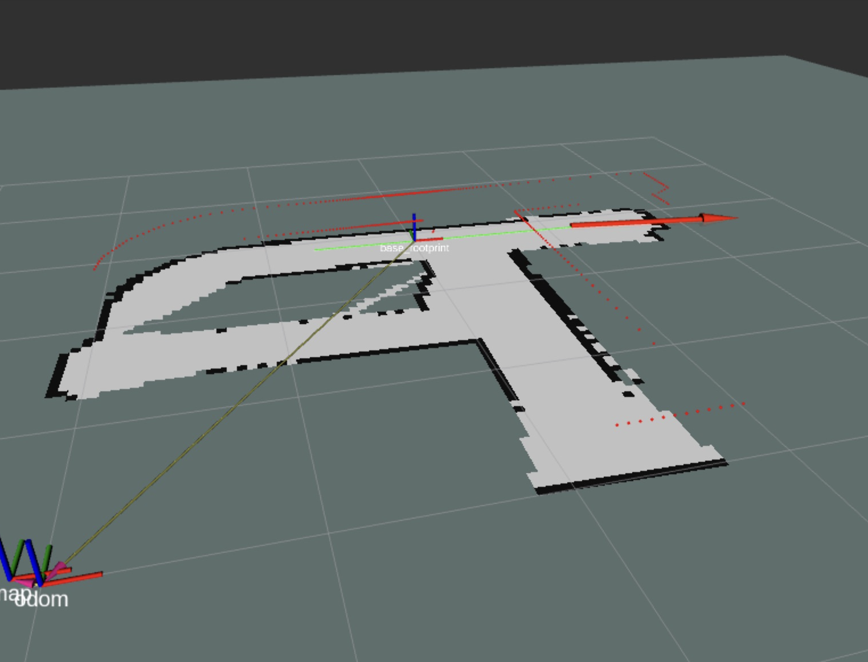
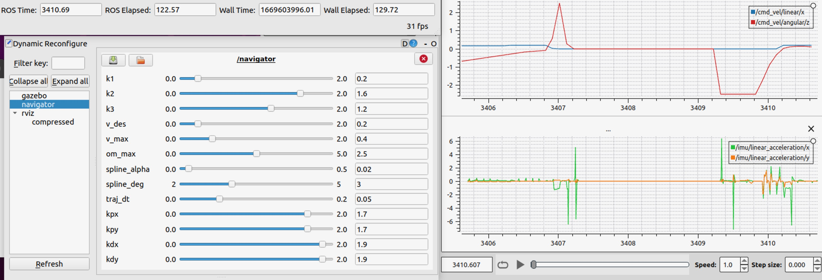
Extensions
4. Live Data Introspection, Parameter Tuning, and Command Center Extension
Extensive live data introspection with PlotJuggler. It is a lightweight visualization tool that directly connects to any running topic and allows for live signal processing
We integrated a complete GUI for live parameter tuning to maintain an overview and intuitive control over all parameters
To have a good overview in rviz, we visualize the point cloud, the goal marker, IMU, and a laser scan

Slide 8




Happy End
Turtelbot saved the world

Slide 9
TA answers:
- How many points will our extensions approximately yield? (multiplexer)+
How detailed should be describe the baseline mission?
Summary:
Stop sign: add more (example: people) to get save 10 points
Live data and plot juggler: 5 points
Animals: 10 points (but not sure)
Command center: baseline, no extension
Multiplexing: should be more complex than in the sections
Generally: More focus on extensions than baseline

Slide 10
To dos:
- slide 4: banana
general: technical details in the graphs?

Slide 11
at stop sign/bananasv
IDLE
STOP_ALIGN
at goal
STOP_SIGN
PARK
near goal
after 3 sec
TRACK
ALIGN
heading error

Slide 12

mode = 0
autonomous
control
manual
control
mode = 1
mode = 0
mode = 1
mode = 2
mode = 2
hybrid
control
A
M
after 3 sec

